Slide 1
Logic Gates
Presentation
on

Slide 2
LOGIC GATE
Logic Gates is an electronic circuit the operates on one or more signals to produce standard output signals .
Logic gate are indicated by the
-Symbol
-Truth Table
-Boolean Algebra

Slide 3
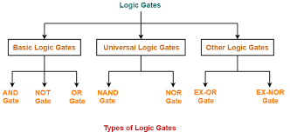
Types of logic gates

Slide 4
AND GATE
A Circuit which performs an AND operation.
It has n input (two or more then 2)and one output.
Output the output of AND gate is high(1) when all the input are high(1).
Algebraic function of AND gate.
X=A.B
AB
A AND B

Slide 5
TRUTH TABLE
FOR
AND GATE
A | B | X(A.B)
0 | 0 | 0
0 | 1 | 0
1 | 0 | 0
1 | 1 | 1

Slide 6
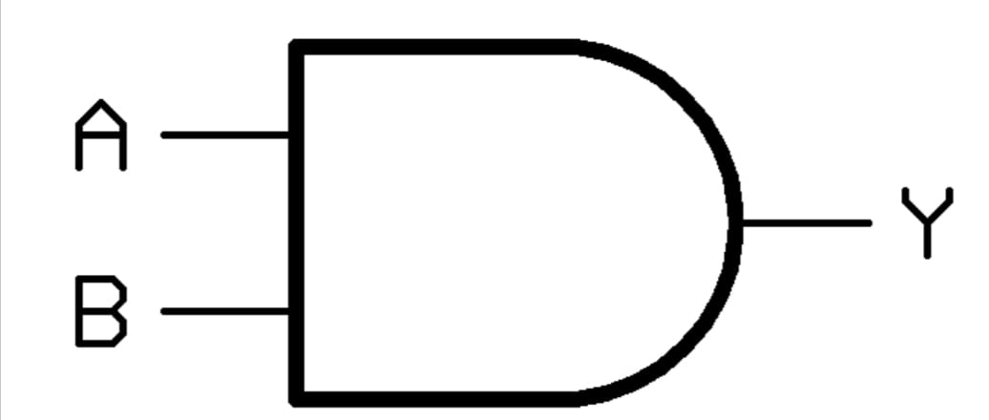
LOGIC DIAGRAM FOR
AND GATE

Slide 7
OR GATE
A Circuit which perform OR operation.
It has n input (n>=2) and one output.
Output the output of OR gate is high (1) when if one or more inputs are high.
Algebraic function of OR gate
X=A OR B
=A+B

Slide 8
TRUTH TABLE
OF
OR GATE
A | B | X
0 | 0 | 0
0 | 1 | 1
1 | 0 | 1
1 | 1 | 1

Slide 9
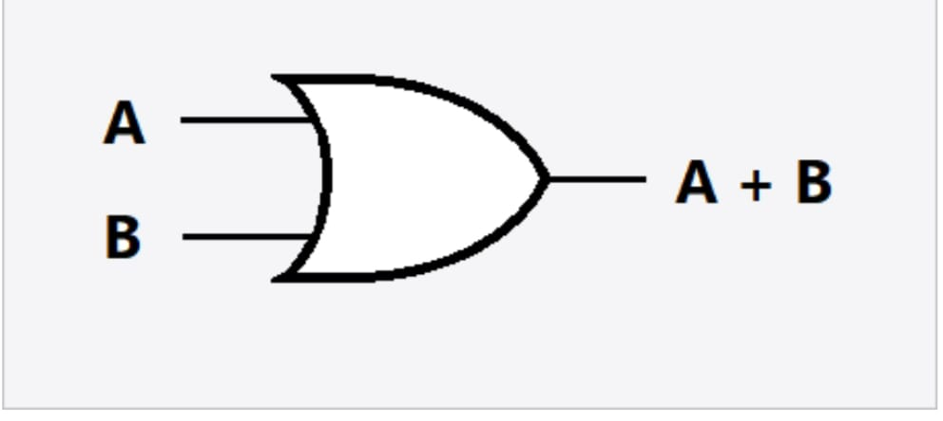
LOGIC DIAGRAM
OF OR
OR GATE

Slide 10
NOT GATE
NOT gate is also known as inverter.
The output of NOT gate is high, when input is low.
Algebraic function of NOT gate.
X=A’
X=NOTA
TRUTH TABLE
A | X
0 | 1
1 | 0

Slide 11

LOGIC DIAGRAM OF
NOT GATE

Slide 12
NAND GATE
It is a combination of AND or NOT gate.
it has n input (n>=2) and one output.
Algebraic function of NAND GATE
X=(AB)’

Slide 13
TRUTH TABLE FOR
NAND GATE
A | B | AB | X
0 | 0 | 0 | 1
0 | 1 | 0 | 1
1 | 0 | 0 | 1
1 | 1 | 1 | 0

Slide 14
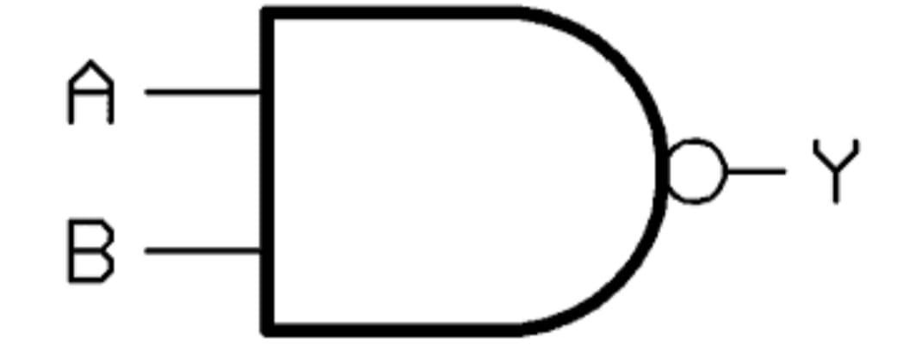
LOGIC DIAGRAM FOR
NAND GATE

Slide 15
NOR GATE
It is combination of OR and NOT gate.
It has n input(n>=2)and one output (output is high when both input and output are low.
Algebraic function NOR gate.
X=A NOR B
(A+B)’

Slide 16
TRUTH TABLE
A | B | A+B | X
0 | 0 | 0 | 1
0 | 1 | 1 | 0
1 | 0 | 1 | 0
1 | 1 | 1 | 0

Slide 17
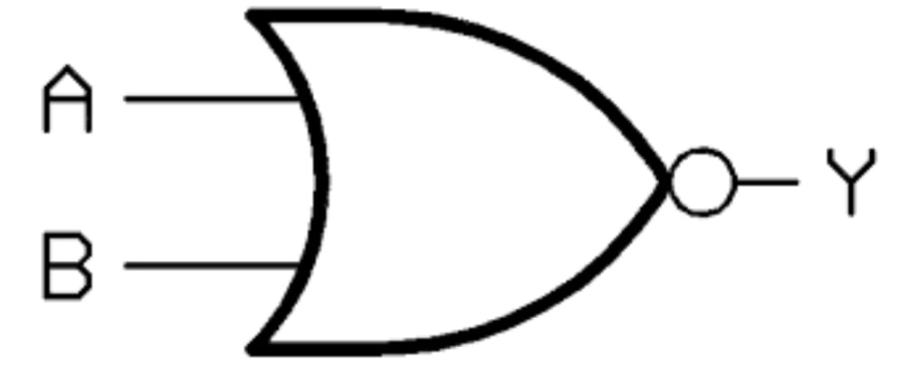
LOGIC DIAGRAM
FOR
NOR GATE

Slide 18
XOR GATE
XOR or EX-OR gate is a special type of gate.
The exclusive-or gate is abbereviated as ex-or gate
X-OR gate.
It has n input (n>=2) and one output.
The output is high when input are not same (one of them is 0 and other one is 1).
Algebraic Function of XOR gate
X=A XOR B
X=A’B’+AB’

Slide 19
TRUTH TABLE FOR
XOR GATE
A | B | X
0 | 0 | 0
0 | 1 | 1
1 | 0 | 1
1 | 1 | 0

Slide 20
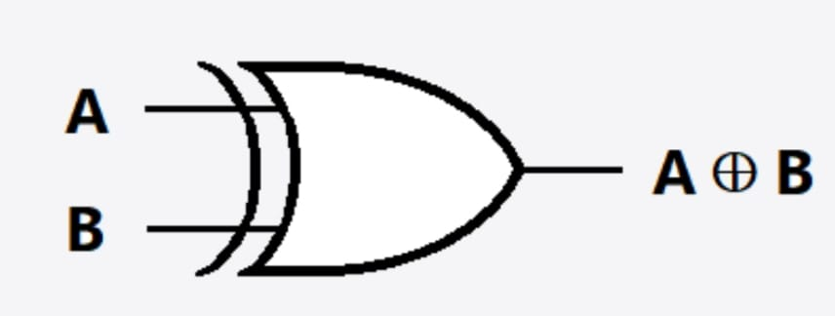
LOGIC DIAGRAM
OF XOR GATE

Slide 21
EX-NOR GATE
IT is logical complement of XOR gate.
It has n input(n>=2) and one output.
The output is high(1) when both inputs 0 or both 1.
Algebraic Function of exclusive NOR
X=A EX-NOR B
=A’B’+AB

Slide 22
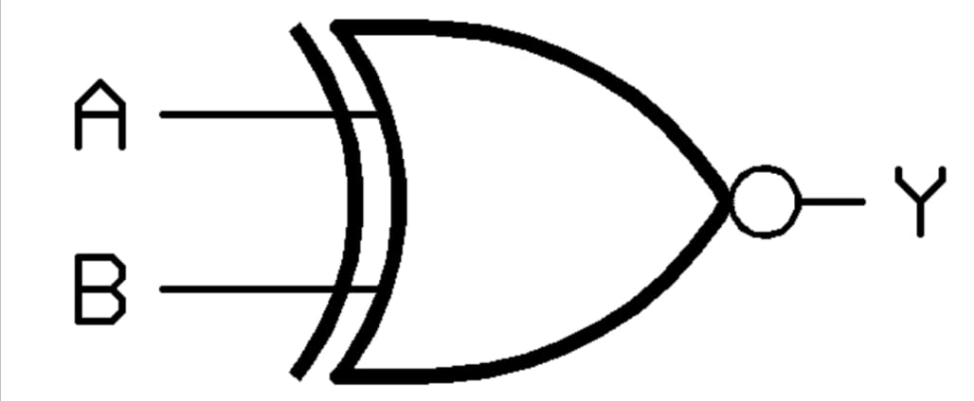
LOGIC DIAGRAM FOR
EX-NOR

Slide 23
Download ppt’s and handwritten notes
JP Web devolpers
Follow on instagram:-@jpwebdevelopers
Thank
you

